Slide 1
Lending Club Case Study SUBMISSION
Group Facilitator: Prabhat Mishra
Team Member: Deepanshu Pradhan

Slide 2
Business Understanding
A consumer finance company specialised in lending various types of loans to urban customers.
When a loan application is received by the company, the company must make a decision to approve the loan based on the profile of the applicant. Two kinds of risks are linked to the choice of the bank
If the applicant is inclined to repay the loan, then not approving the loan will result in a business loss to the company
If the applicant is unlikely to repay the loan, i.e. if the applicant is inclined to default, then approving the loan may result in a financial loss to the company.
If the firm approves the loan, there are three possible scenarios outlined below:
Fully paid: Applicant has fully paid the loan (the principal and the interest rate)
Current: Applicant is in the process of paying the instalments, i.e. the tenure of the loan is not yet completed.
Charged-off: Applicant has not paid the instalments in due time for a long period of time, i.e. he/she has defaulted on the loan

Slide 3
Business Objective
Lending loans to ‘risky’ applicants is the largest source of financial loss (called credit loss). In other words, borrowers who default cause the largest amount of loss to the lenders. Such customers labelled as 'charged-off' are the 'defaulters'.
The objective is to understand the driving factors (or driver variables) behind loan default. The company can utilise this knowledge for its portfolio and risk assessment.

Slide 4
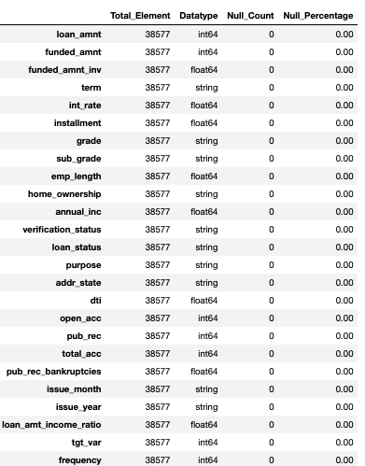
Analysis- Flowchart
Following steps are performed:
1. Data Sourcing
Checking the encoding of the file
Loading the data
2. Data Cleaning
Null Values Analysis
Identify and drop columns with 100% missing data
Identify and drop columns with more than 80% missing data
Identify and drop columns having single unique values as they will not any value to the analysis
Identify and drop unnecessary columns (like text based, Applicant Loan Behaviour)
B. Datatype Check
C. Datatype Conversion
1. Converting text to float values like interest_rate, emp length
D. Drop Records
1. Drop Duplicates
2. Drop records for current records
E. Impute Null Values
F. Derived Metrics
1. Derive month and year from issue_date
2. Derive loan amount and annual income ratio
3. Adding target variable based on loan_status

Slide 5
Analysis
3. Univariate Analysis:
A. Continuous Variables (Loan Amount, Annual Income, Interest Rate, DTI, Target Variable Default Percentage, Employee Length
B. Categorical Variables ( Address State, Grade, Home Ownership, Issue year, Sub Grade, Purpose, Term, Verification Status
4. Bi/Multivariate Analysis:
A. Heatmap for continuous variable
B. Pair Plot for continuous variable
C. Target Variable vs (Loan Amount, Annual Income, Interest Rate, DTI, Open Account, Derogatory Public Record, Employee Length, Address State, Grade, Home Ownership, Issue year, Sub Grade, Purpose, Term, Verification Status, Issue Month
D. Issue month vs Purpose vs Target Variable
E. Loan Amount Income Ratio, Interest vs Target Variable

Slide 6
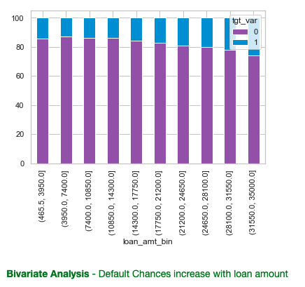
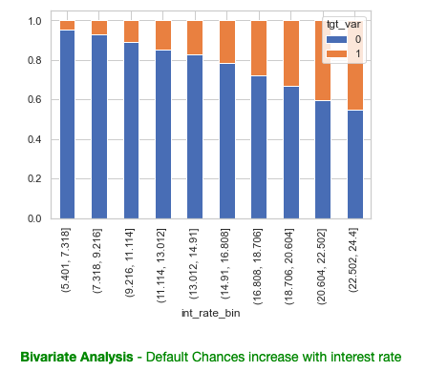
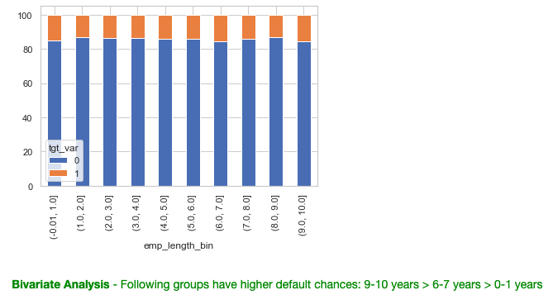
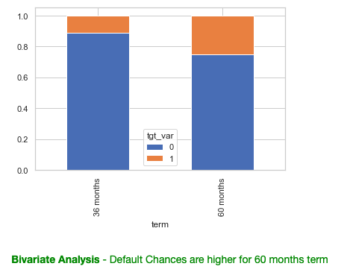
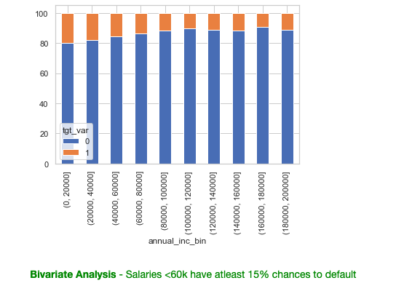
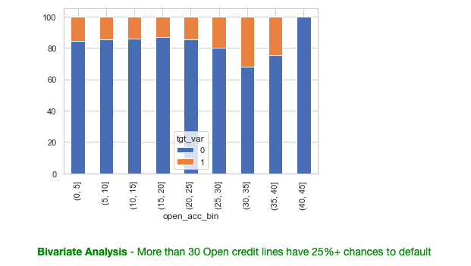
Driving Factors Behind Loan Default

Slide 7
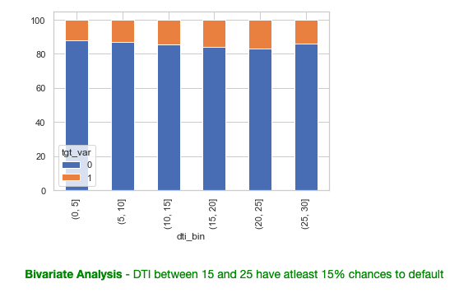
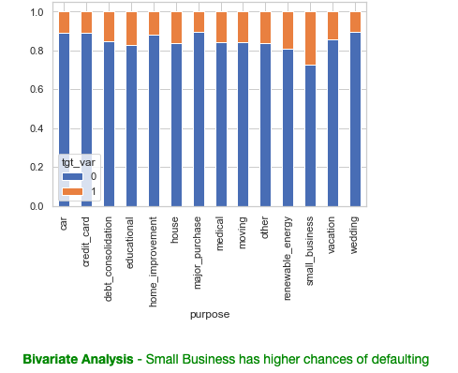
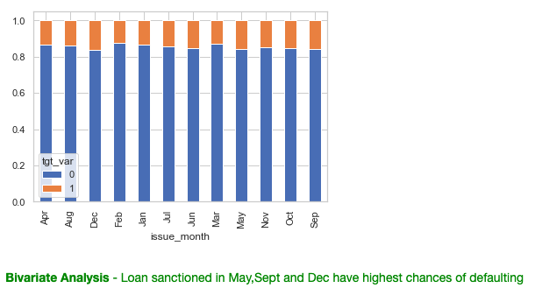
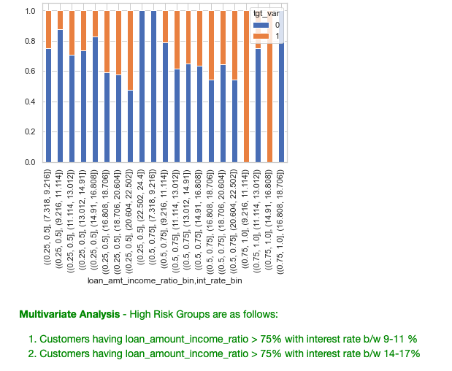
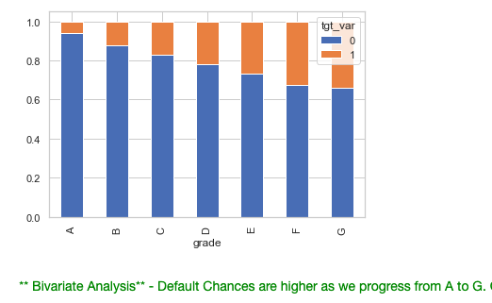
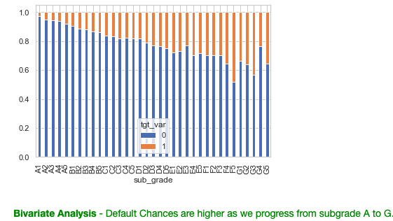
Driving Factors Behind Loan Default

Slide 8
Conclusion
Based on the analysis performed on the data available. Below are the values which are impacting the loan being charged-off:
1. Grade F & G
2. 9-10+ Years Employee length
3. Purpose-Small Business & Vacation
4. Issue Month : May, Sept and Dec
5. Term- 60 months
6. Interest Rate: > 9%
7. Annual Income: <60k
8. State: Nebraska
9. Open Credit Line: 30+
10. Loan Amount: > 20k
11. DTI: 15-25

